Slide 1
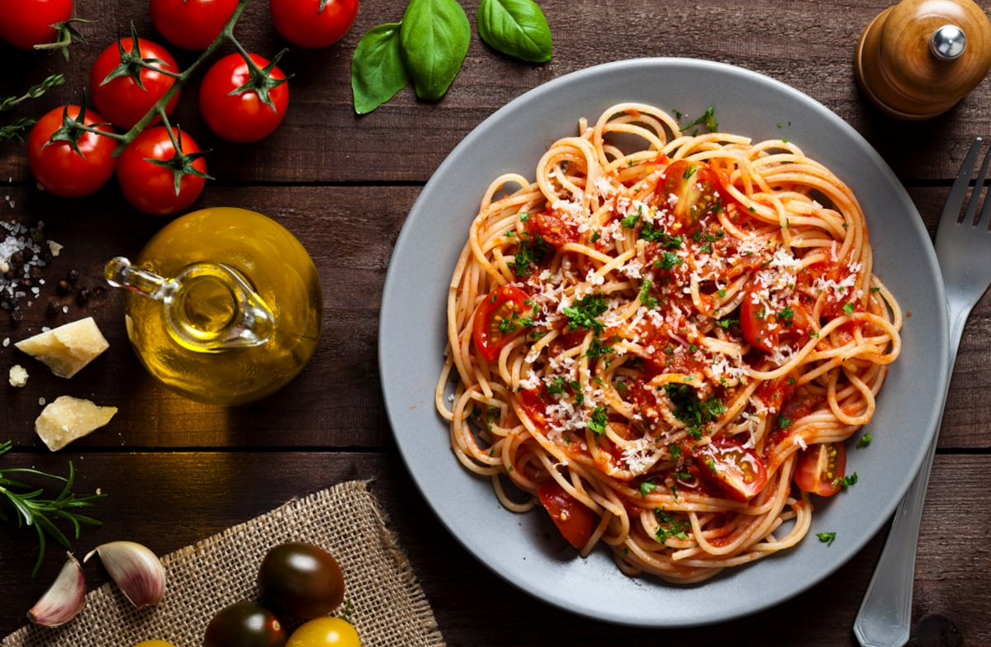



Classroom Delivery
Academic Year 2023/24

Slide 2

GEMS DUBAI AMERICAN ACADEMY
Classroom Delivery
KG1 TO GRADE 2

Slide 3
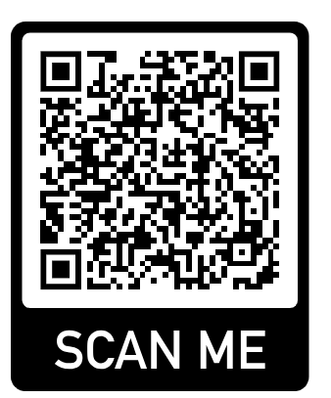
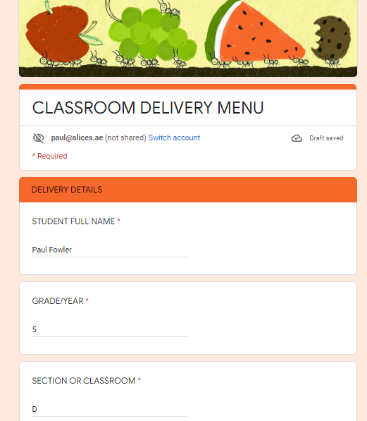
Classroom Delivery
Ordering
Scan the code or click the attached link
https://docs.google.com/forms/d/e/1FAIpQLSdrsAZwN1Jwbx18gpFoe7t700fbT4JkgSwfRtLJpBm6c_EA5w/viewform?usp=sf_link
Complete your details and select your meal

Slide 4
Classroom Delivery
Food is prepared & packaged in Slices – A Rated & HACCP certified kitchen
Food is delivered to the school on the day of consumption
All food is stored and delivered at it is optimum temperature
  Hot food is heated and delivered hot
  Cold food is maintained cold and delivered chilled
All utensils and packaging are biodegradable food grade and included within the packaged delivery such as cutlery, napkins
Slices onsite team download the order, prepare and deliver directly to the classroom at the agreed break time

Slide 5
Classroom Delivery
Menu
Breakfast – AED 15
Step 1 – Choose your main item
Blueberry Yoghurt
Mini Cheese and Tomato Slider
French Toast with Berry Compote and Yoghurt
Turkey Cheese Croissant
Egg Mayo Sandwich
Banana Strawberry Yoghurt
Step 2 – Choose your drink
Milk 200Ml
Fresh Orange Juice 200Ml
Lunch – AED 20
Step 1 – Choose your main item
Chicken Mayo Sandwich
Spaghetti Napolitana
Beef Meatball with Baked Potato
Daily Menu Vegetarian
Daily Menu Non-Vegetarian
Step 2 – Choose your side item
Caesar Salad
Sweet Corn
Roasted Vegetable
Crudities
Step 3 – Choose your dessert item
Grapes & Berries
Mixed Fruit Pot
Pineapple Pot
Red Fruit Pot
Banana

Slide 6
Classroom Delivery
Payment
All GEMS school children are automatically enrolled for the Slices Catering Fee Payment system upon school enrollment
Student details are updated upon enrolment
Parents can access the Catering Fee Payment system via the GEMS Parent Portal using the existing login details at https://connect.gemseducation.com/
The Parent Portal enables parents to:
  Top-up online using a debit or credit card, cash top-ups can also be completed in school at any of the Slices counters
  Review their balances and top-up history
  Monitor their child’s usage
The Catering Fee Payment system is accessible from the drop-down option of Fees
The cashier will process the transaction and the student balance will be adjusted accordingly and updated on the GEMS Parent Portal

Slide 7
Classroom Delivery
FAQ’s
        1. How do I place online classroom delivery order for my kids?
        Scan the QR code or open the provided google link for online classroom delivery orders, place your weekly order then confirm student name, grade, classroom, parents contact details and submit your order
        2. How often or when I can place my order?
        Every Tuesday at 11 AM and closes every Friday at 11 AM
        3. What if I did not place my order on given order cut off time?
        After the cut off time of ordering, the online ordering form will no longer accept any changes, Hence your order will not proceed
        4. Is there any other resource to place classroom delivery order? Such as WhatsApp or email
        No, WhatsApp and email orders will not be acceptable
        5. How does the payment system works for classroom delivery?
        The amount will be deducted from the given child account after the classroom delivery
        6. How and when I can cancel my order?
        Order cancelation can be done 48hours in advance by sending an email to customersupport@slices.ae
        7. How does refund system work?
        Any refund will be reviewed by sending an email to customersupport@slices.ae via your registered email id
        8. I have a query on my account, who should I contact?
        For any queries, please contact customersupport@slices.ae

